Slide 1

TITLE PAGE
Problem Statement ID: FT009
Problem Statement Title: Gig Worker Payment & Benefits Platform
Domain: Fintech
Team Name: Finovators
Team Leader Name: Nihal Mishra

Slide 2
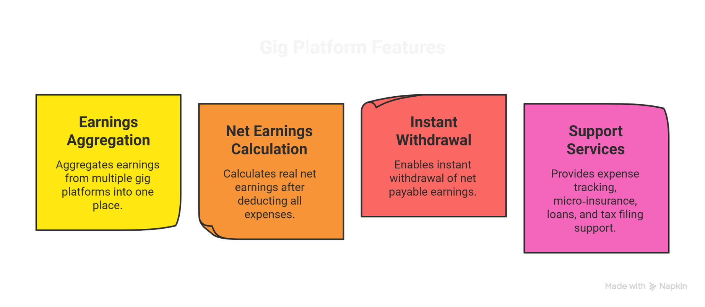
Idea/Approach Details
Gig workers earn daily but operate without liquidity, financial clarity, or safety nets due to delayed settlements and fragmented earnings across platforms.
Our solution is a unified financial operating system for gig workers that:
The platform is ledger‑based and works without relying on bank transaction data or manual receipts, making it scalable and practical.
Net Earnings Calculation
Calculates real net earnings after deducting all expenses.
Support Services
Provides expense tracking, micro-insurance, loans, and tax filing support.
Earnings Aggregation
Aggregates earnings from multiple gig platforms into one place.
Instant Withdrawal
Enables instant withdrawal of net payable earnings.
We compute instant liquidity from earnings data, not from bank balances or settlements.

Slide 3
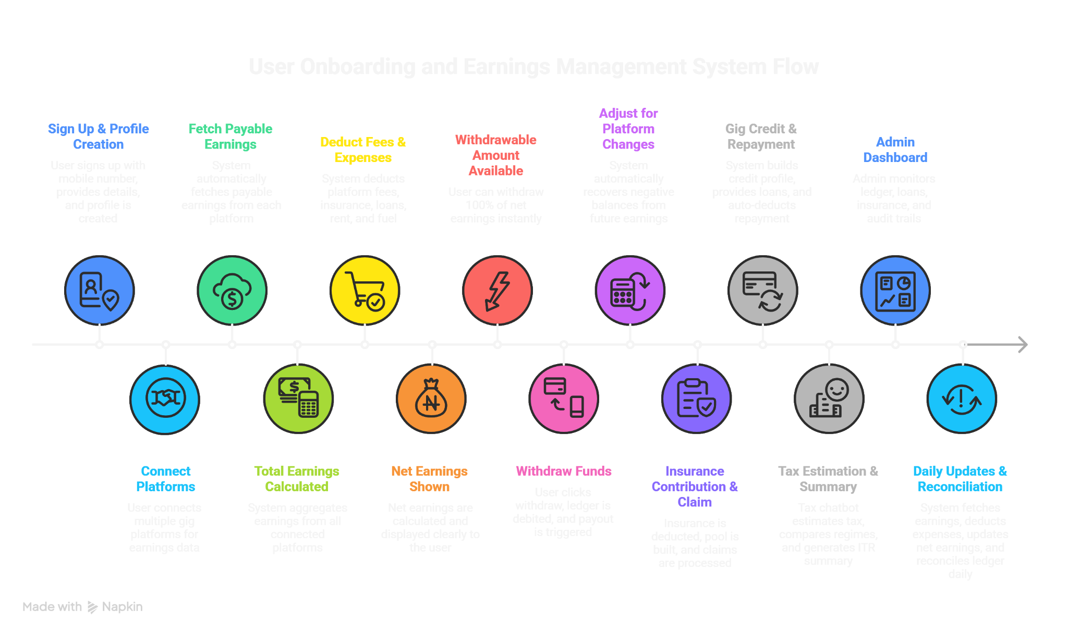
Process Flow Diagram
Fetch Payable Earnings
System automatically fetches payable earnings from each platform
Deduct Fees & Expenses
System deducts platform fees, insurance, loans, rent and fuel
Withdrawable Amount Available
User can withdraw 100% of net earnings instantly
Adjust for platform changes
Automatic negative balance recovery from future earnings.
Gig Credit & Repayment
Credit profiling, loan disbursal, and auto-repayment.
Admin Dashboard
Admin monitors ledger, loans, insurance and audit trails
Sign Up & Profile Creation
Mobile signup and profile creation.
Insurance Contribution & Claim
Insurance pooling and claims processing.
Tax Estimation & Summary
Tax estimation, regime comparison, and ITR summary.
Daily Updates & Reconciliation
Daily earnings calculation and ledger reconciliation.
Connect Platforms
Multi-platform gig earnings integration.
Total Earnings Calculated
System aggregates earnings from all connected platforms
Net Earnings Shown
Net earnings are calculated and displayed clearly to the user
Withdraw Funds
User clicks withdraw, ledger is debited, and payout is triggered

Slide 4
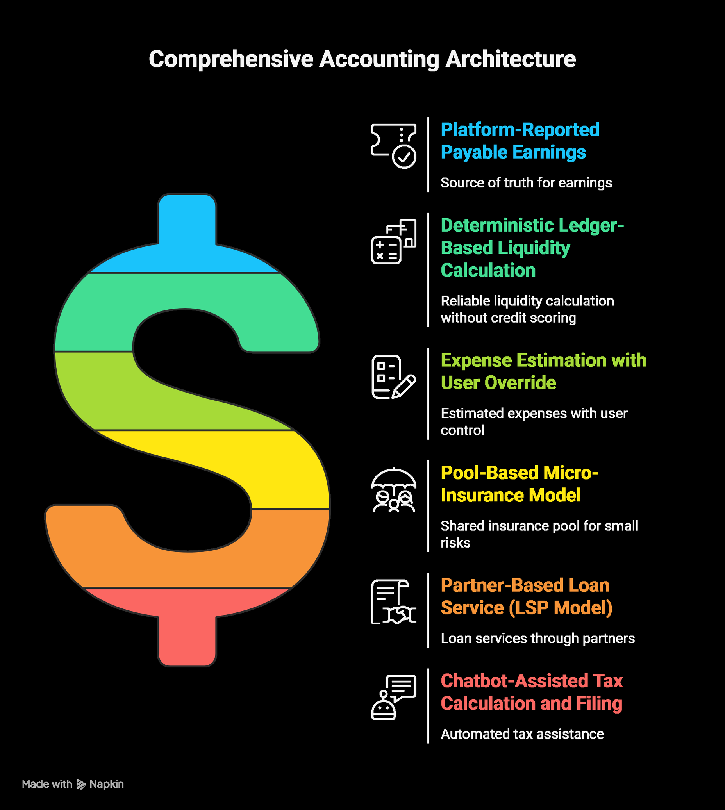
Methodology Used
This methodology ensures low friction, financial accuracy, and scalability.
MVP focuses on ledger, earnings aggregation, and instant withdrawal; other services are built as modular extensions.

Slide 5
Solution Concept & Feasibility
Solution Concept : A financial layer on top of gig platforms that converts earnings into usable money instantly, while also enabling long‑term financial security.
Feasibility (24‑Hour Build)
The solution is feasible within a hackathon timeframe because the core innovation is rule‑based and ledger‑driven, not integration‑heavy.
Gig platform data is mocked/simulated to validate logic
No real money movement or regulatory integration is required
The MVP focuses on earnings aggregation, ledger calculation, and instant withdrawal simulation
Insurance, loans, and tax features are ledger‑powered demo flows
The demo focuses on ledger + instant withdrawal; other services reuse the same ledger data..

Slide 6
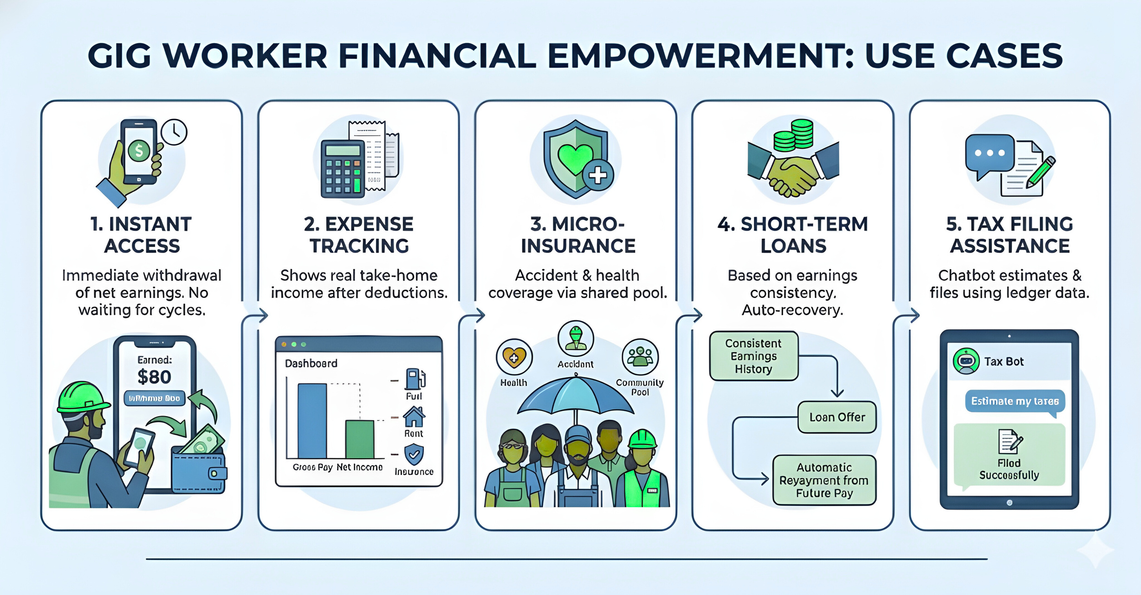

Use Cases & Description
₹
Immediate withdrawal
of net earnings. No
waiting fot cycles.
Shows real take-home
income after deductions.
Accident & health coverage via shared pool
Based on earnings
consistency.
Auto-recovery.
Chatbot estimates & files using ledger data.
Consistent
Earning History
Earned:
Dashboard
Accident
₹80
Health
Withdraw ₹80
Fuel
Community
Pool
Loan Offer
Estimate my taxes
Rent
Gross Pay Net Income
Insurence
Automatic
Filed
Successfully
Repayment From Future
Pay

Slide 7
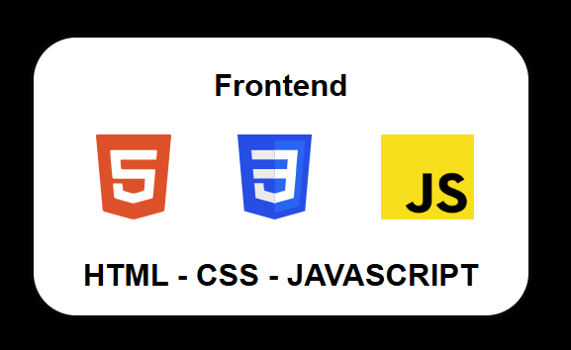
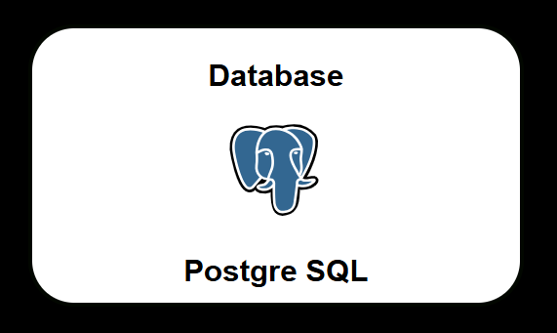
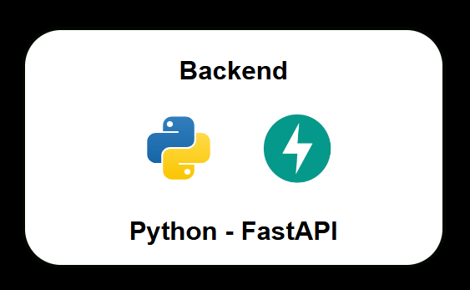
Technology Stack Used

Slide 8
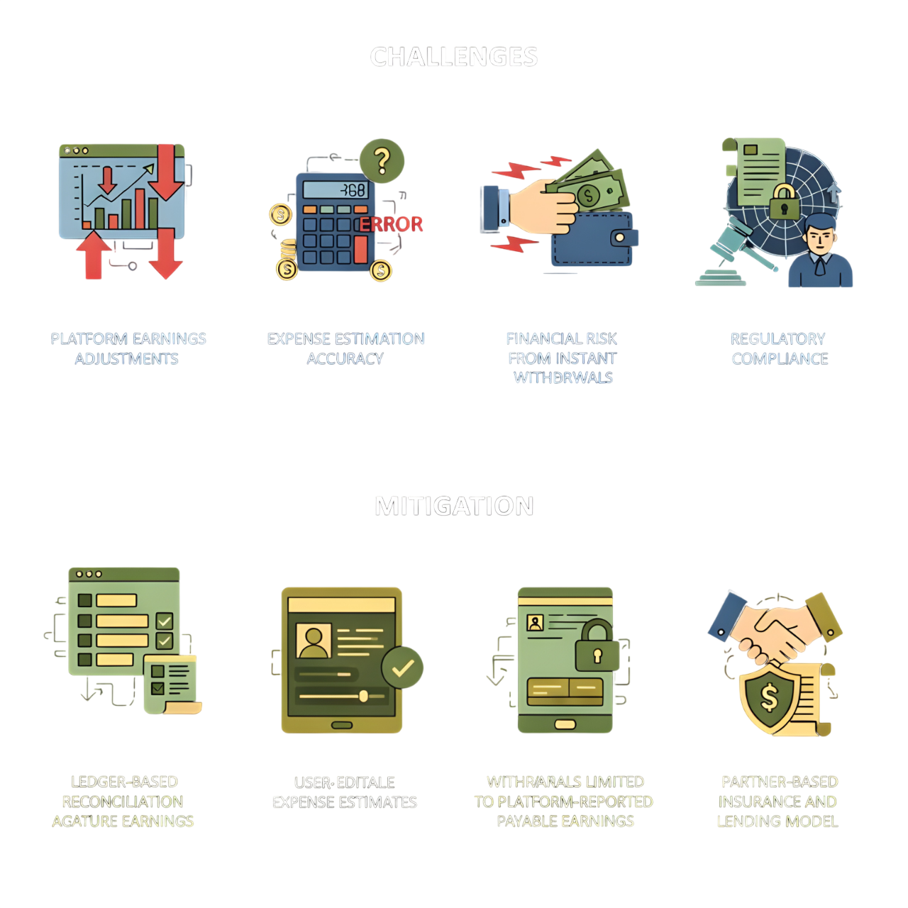
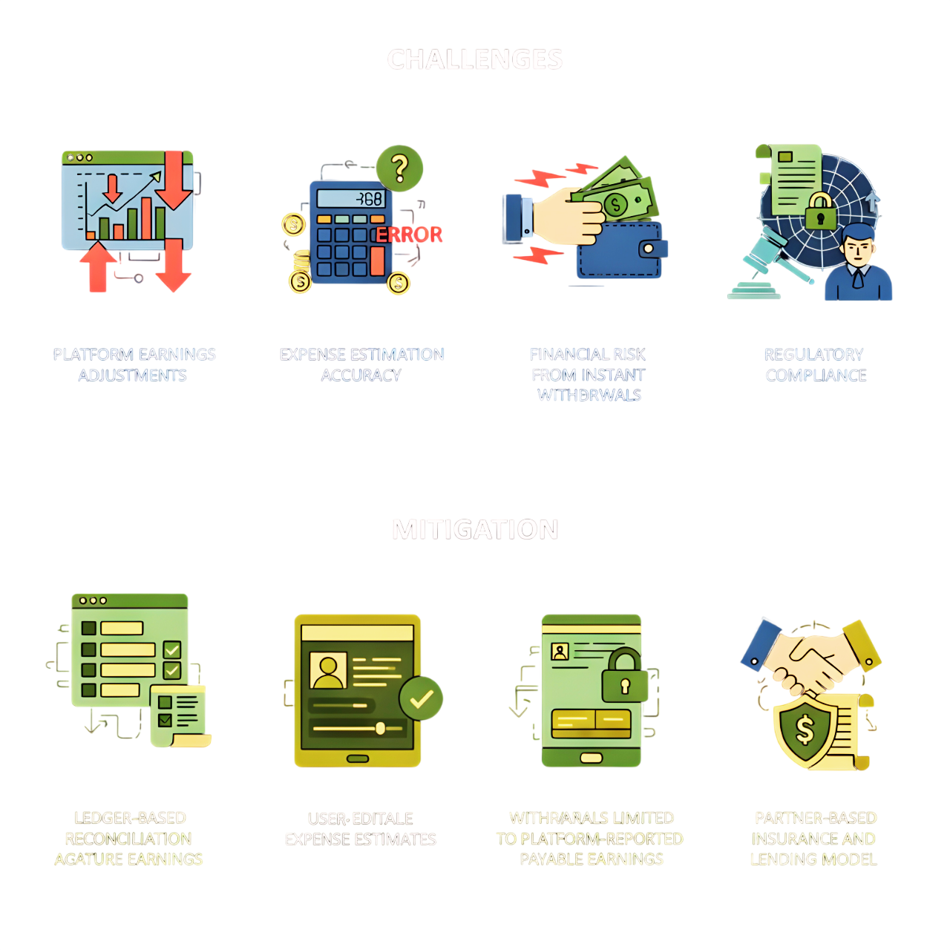
Constraints
Challenges
Mitigation
Platform earnings adjustments
Expense estimation accuracy
Ledger‑based reconciliation against future earnings
User‑editable expense estimates
Financial risk from instant withdrawals
Withdrawals limited to platform‑reported payable earnings
Partner‑based insurance and lending model
Regulatory compliance

